Slide 1

Fake News Project
Mahaboob Basha Shaik

Slide 2
Problem Statement
The authenticity of Information has become a longstanding issue affecting businesses and society, both for printed and digital media. On social networks, the reach and effects of information spread occur at such a fast pace and so amplified that distorted, inaccurate, or false information acquires a tremendous potential to cause real-world impacts, within minutes, for millions of users. Recently, several public concerns about this problem and some approaches to mitigate the problem were expressed.

Slide 3
EDA
It is important to note that this "unnecessary text" elimination process
could be more successful when followed in a particular sequence.
For instance, elimination of special characters before removal of
hashtags, usernames defeats our purpose as the text following a '#' could be
considered a token.
Here is the sequence we will implement:
HTML codes (if present)
URLs/ email addresses
Hashtags/Usernames
Emojis
Stopwords
Expanding Abbreviations
Punctuations
Special characters/ Numbers

Slide 4

Assumption
The goal is to create a classifier model that can predict if input text is inappropriate (Fake).
1. Explore the dataset to get a better picture of how the labels are distributed, how they correlate with each other, and what defines fake and true News.
2. Create a baseline score with a simple logistic regression classifier.
3. Explore the effectiveness of multiple machine learning approaches and select the best for this problem.
4. Select the best model and tune the parameters to maximize performance.
5. Build the final model with the best performing algorithm and parameters and test it on a holdout subset of the data

Slide 5
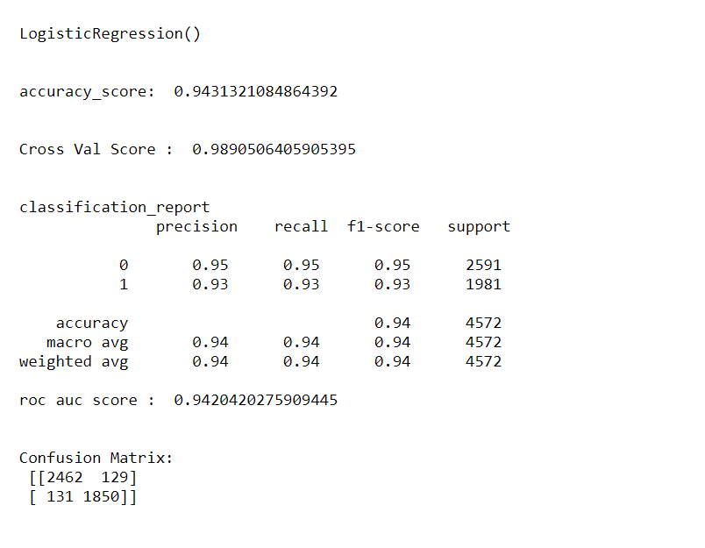
Logistic Regression

Slide 6
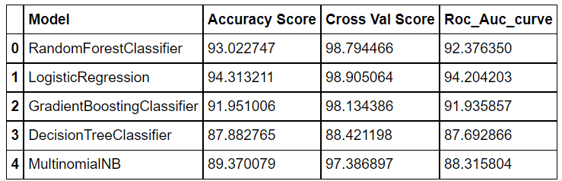
Summary of Models

